Slide 1

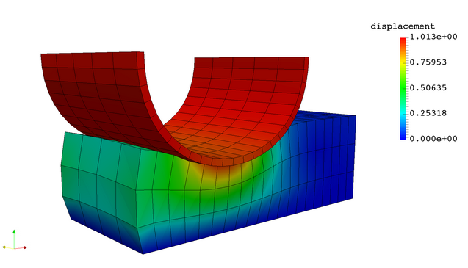
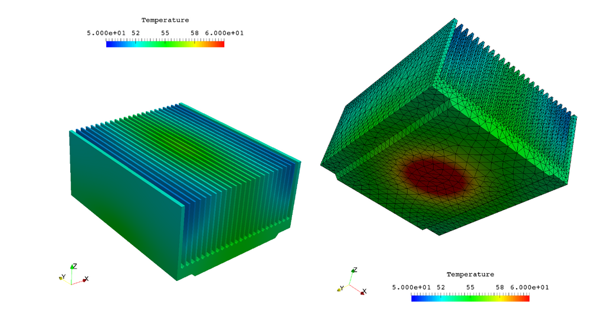
JuliaFEM
Open Source Finite Element method Solver

Slide 2
About
The JuliaFEM project develops open-source software for reliable, scalable, distributed Finite Element Method.
JuliaFEM is a FEM software project started in May 2015 and written using Julia.
The JuliaFEM software library is a framework that allows for the distributed processing of large Finite Element Models across clusters of computers using simple programming models.
It is designed to scale up from single servers to thousands of machines, each offering local computation and storage.
The basic design principle is: everything is nonlinear. All physics models are nonlinear from which the linearization are made as a special cases.
Software is MIT licensed. Main difference to other popular licenses like GPL is that MIT doesn’t require modifications be open sourced whereas GPL does.
Aim of the project is to provide simple programming models to write own solvers in a robust way; using more traditional programming languages like FORTRAN amount of lines of code is easily ten times more compared to Julia. This makes it possible to develop the software in a cost effective way.

Slide 3
Road map
Version | Degrees of Freedom [M] | Number of cores
0.1.0 | 1 | 10
0.2.0 | 10 | 100
1.0.0 | 100 | 1000
2.0.0 | 1000 | 10000
3.0.0 | 10000 | 100000

Slide 4
Vision
On one hand, the vision of the JuliaFEM includes the opportunity for massive parallelization using multiple computers with MPI and threading as well as cloud computing resources in Amazon, Azure and Google cloud services together with a company internal server.
And on the other hand, the real application complexity including the simulation model complexity as well as geometric complexity, see some examples in.
Not to forget that the reuse of the existing material models as well as the whole simulation models are considered crucial features of the JuliaFEM package.
Recreating the wheel again is definitely not anybody's goal, and thus we try to use and embrace good practices and formats as much as possible. We have implemented Abaqus/Calculix input-file format support and maybe will in the future extend to Other FEM solver formats. Using modern development environments encourages the user towards fast development time and high productivity. For developing and creating new ideas and tutorials, we have used Jupyter notebooks to make easy-to-use handouts.
The user interface for JuliaFEM is Jupyter Notebook, and Julia language itself is a real programming language. This makes it possible to use JuliaFEM as a part of a bigger solution cycle, including for example data mining, automatic geometry modifications, mesh generation, solution, and post-processing and enabling efficient optimization loops. In the next section a concrete example including statistical inference combined to FEM calculation is shown.

Slide 5
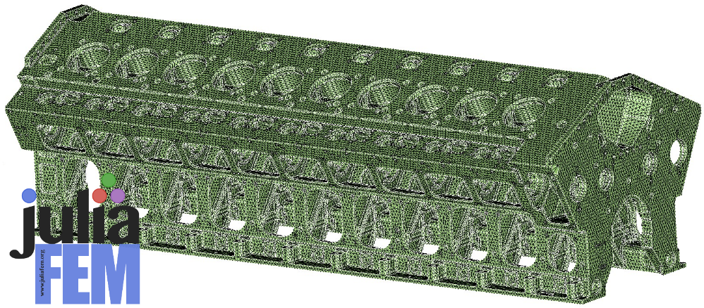
Big numerical example
Typical examples in industrial applications include non-linear solid mechanics, contact mechanics, finite strains, and fluid structure interaction problems. Here there is some simulation of machine parts having different amounts of elements and DOF's for comparison reasons. These simulations take a lot of computational resources, and here are specs of the used hardware: 24 x Intel(R) Xeon(R) CPU E5-2690 v3 @ 2.60GHz with 512 GB total memory.
DOFS [M] | Assembly time (s) | Solution time (s) | Total time
3.0 | 458 | 312 | 16 min
10.8 | 3257 | 3255 | 2 h 4 min
12.6 | 3654 | 6318 | 3 h 4 min

Slide 6
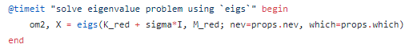
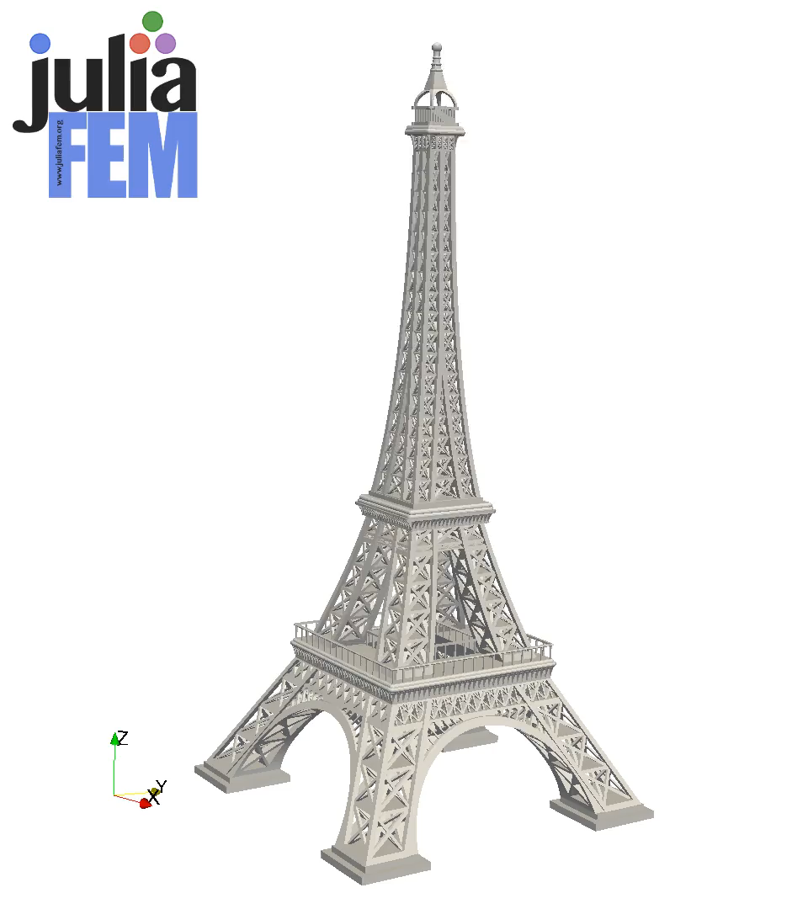
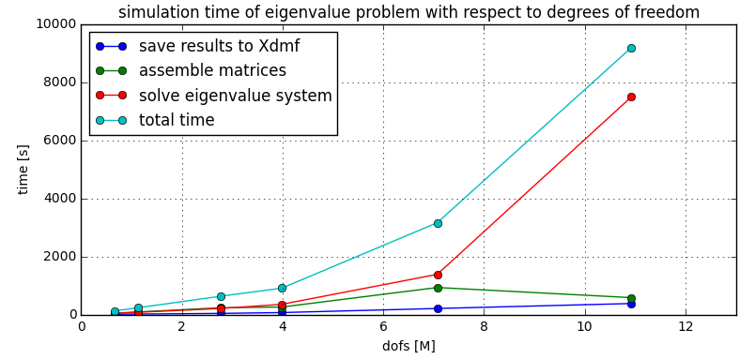
Solving eigenvalues of large models
80 % of time
is used here
look here
don’t look here
80 % of the simulation time is used in a single command: om2, X = eigs(K, M)
What we can optimize, is the rest 20 %.
Or maybe we are just happy to get 80 % of performance using 10 % of effort, and put the rest 90 % of effort to nice things like designing new features and doing research.
JuliaFEM is under 10 kloc and that should be considered as a good thing.
Small code base makes the project attracting for newcomers and we don’t have ancient “payload” we have to take care of. JuliaFEM is fast to develop.

Slide 7
Benefits compared to other FEM softwares
JuliaFEM is excellent tool for rapid prototyping of new ideas. The benefits of using scripting languages is that development speed is superior compared to more traditional programming languages. (C, FORTRAN, etc.)
Julia is JIT compiled programming language, so it does not lose in performance compared to e.g. C and FORTRAN. Other scripting languages like Python, Perl etc. have performance issues and they are not suitable for so called ”hot loops”.
Because of it’s license choise, modifications done to JuliaFEM does not have to be published and public. GPL is much more restrictive than MIT license. JuliaFEM solver can be used inside closed softwares and it’s possible to create whole new products using JuliaFEM inside of them. A concrete example: create a new analysis software with a nice GUI and use JuliaFEM solver inside it.
FEM models can be run inside notebooks or other programming environments. FEM models can be combined to other workflows, e.g. data analysis, machine learning + FEM in same notebook.

Slide 8
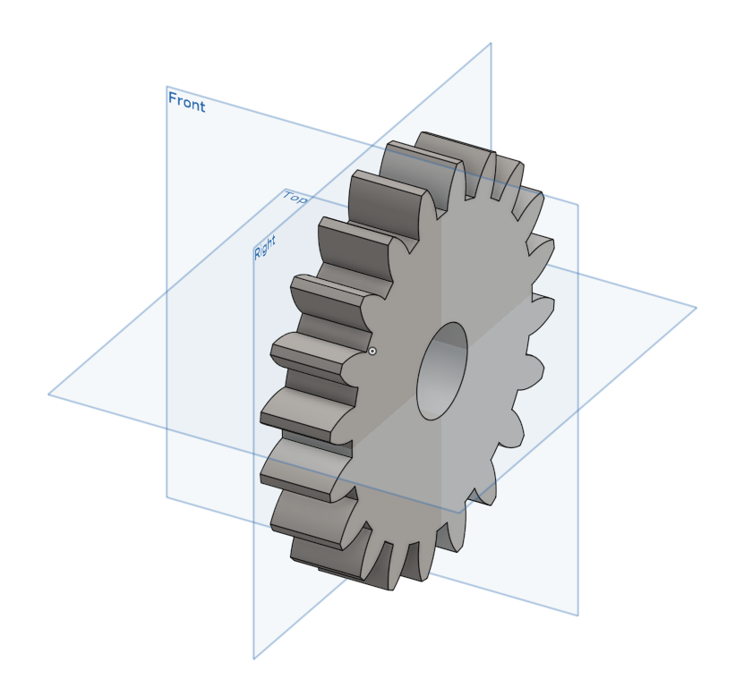
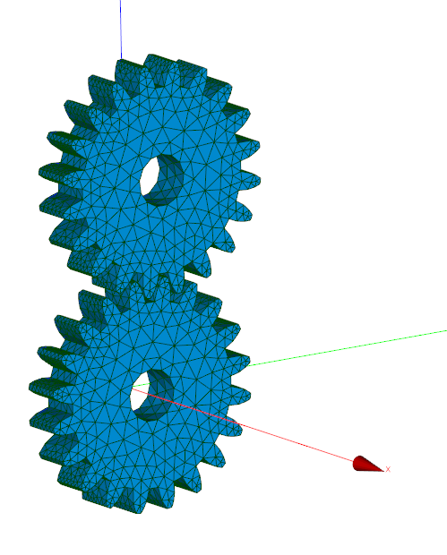
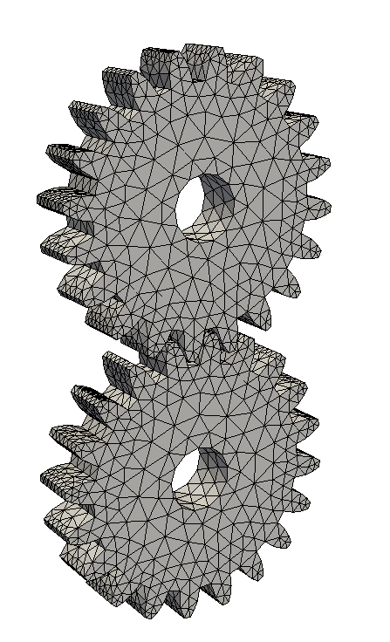
Supported file formats
Currently it’s possible to import mesh in ABAQUS .inp format and in SALOME .med format.
It’s relatively easy to write own reader for some spesific file format, e.g. for Ansys or gmsh
ABAQUS .inp reader is 250 lines of code and SALOME .med reader is 300 lines of code.
Results can be exported to Xdmf format (XML + HDF) and visualized using Paraview.
One possible workflow using OnShape + SALOME + Paraview is shown below
No CAD engine, geometry modelling, meshing tools available, not even on plans. Mesh must be created some other software (SALOME, gmsh, NetGen, SimLab, ...)
Geometry modeling using OnShape
Meshing using SALOME
Visualization using ParaView

Slide 9
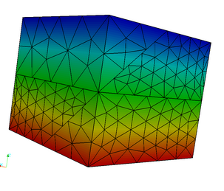
Mechanics, assemblies
Parts can be tied together so that unknown field is transferred from one body to another.
In left figure part is divided to several different bodies and then ties back to one piece using tie contacts.
Figure: mesh tying in thermal analysis.

Slide 10
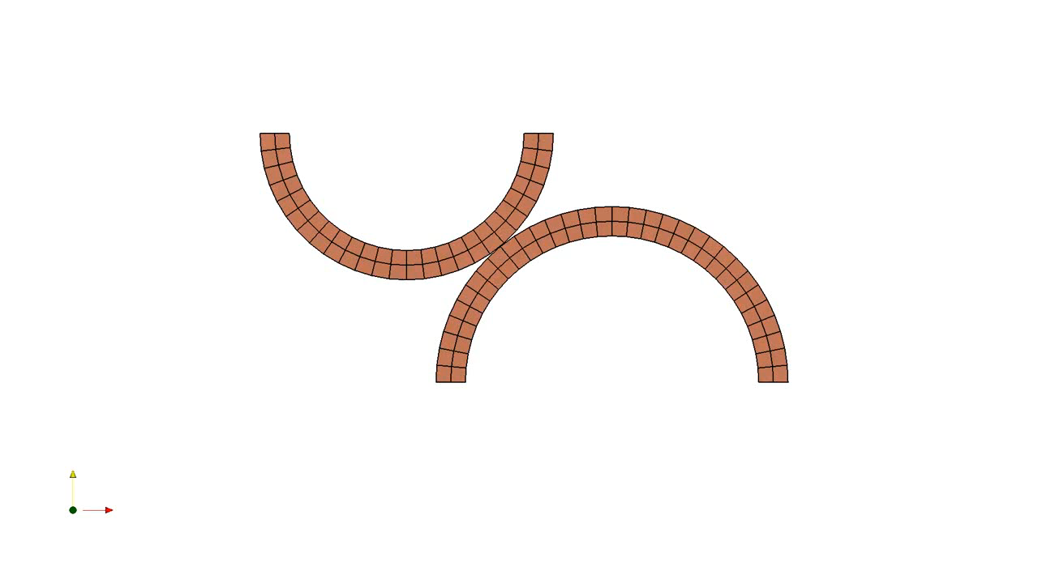
Mechanics, contact modelling
Small strain 2d and 3d frictionless contacts are supported. So called mortar method is used in contact models.
Finite strain 2d is supported.
Future plans: 3d finite strain + friction models.

Slide 11
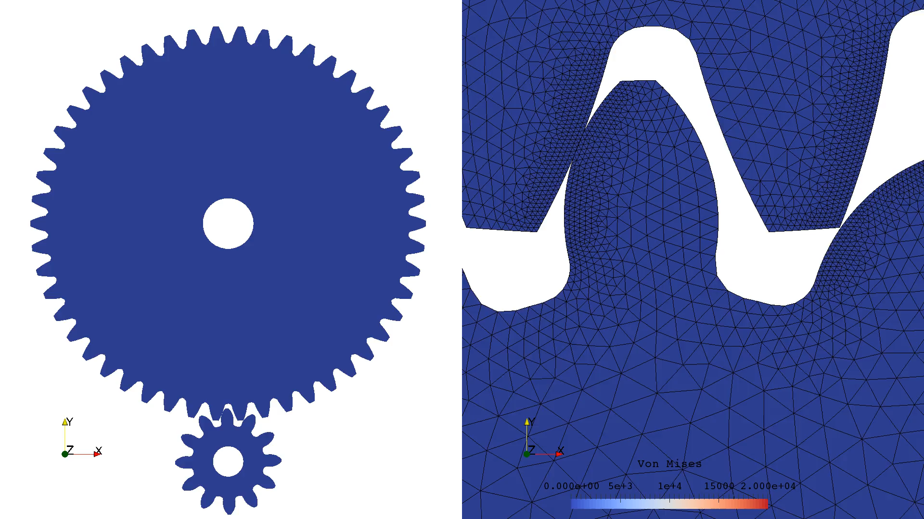
Mechanics, 2d contact modelling

Slide 12
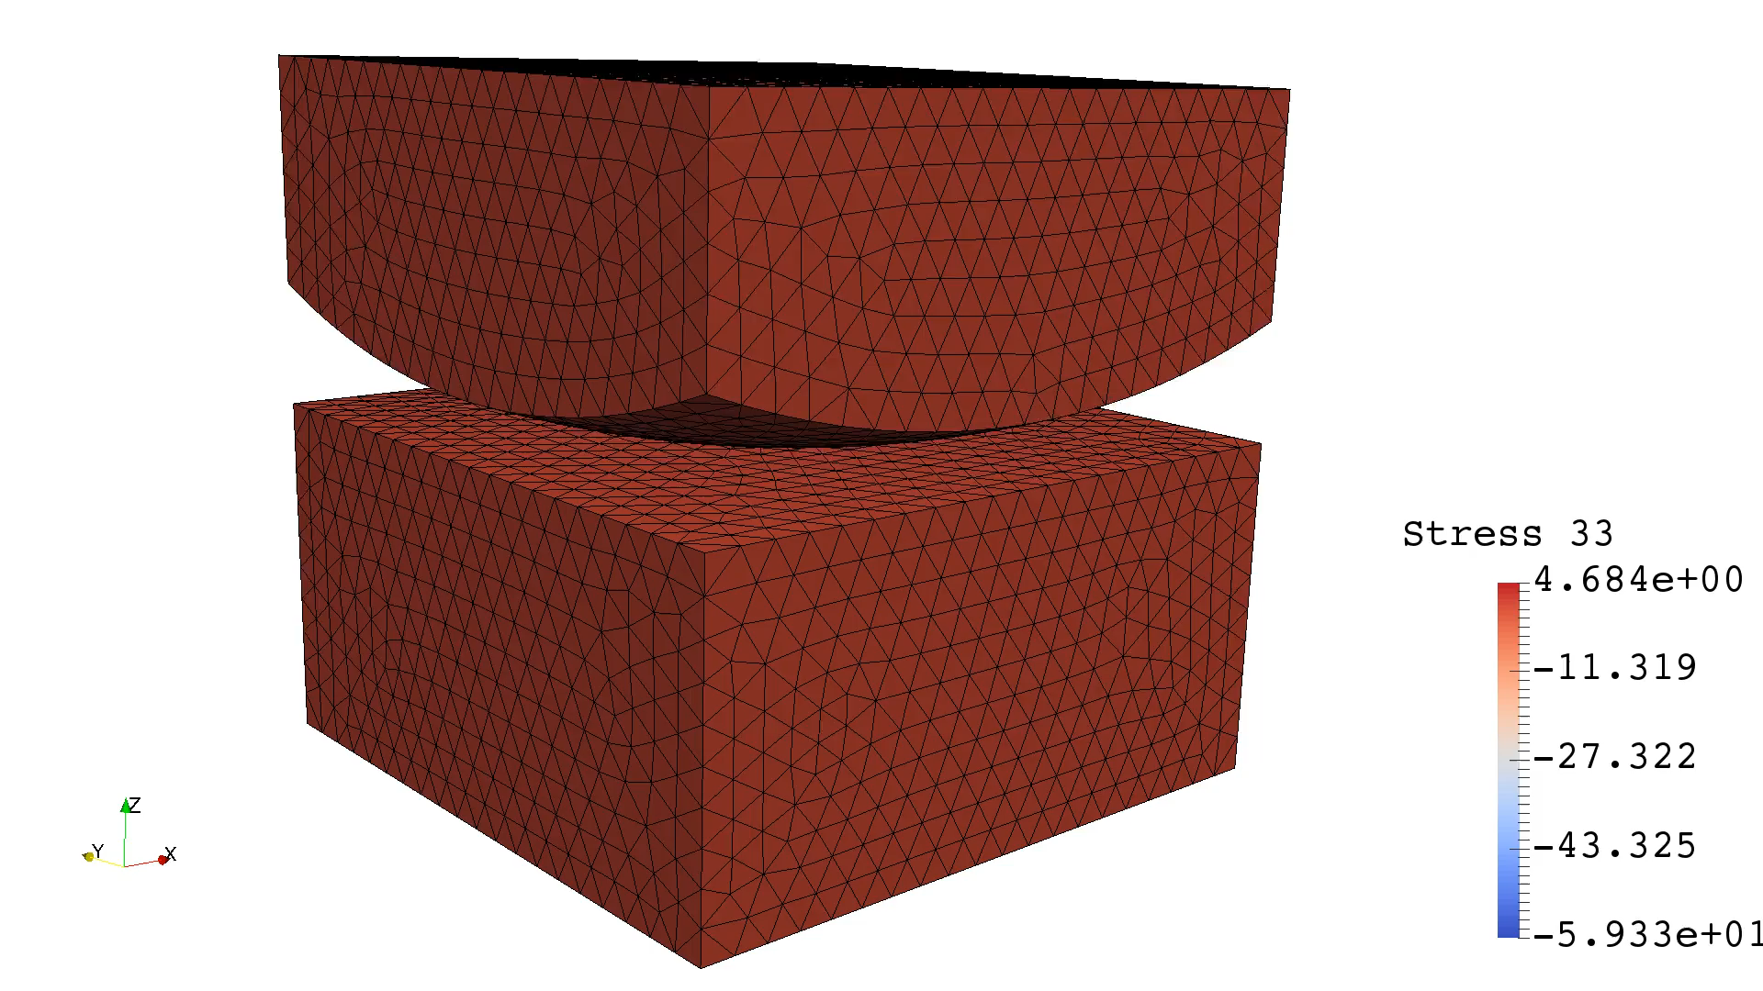
Mechanics, 3d contact modelling

Slide 13
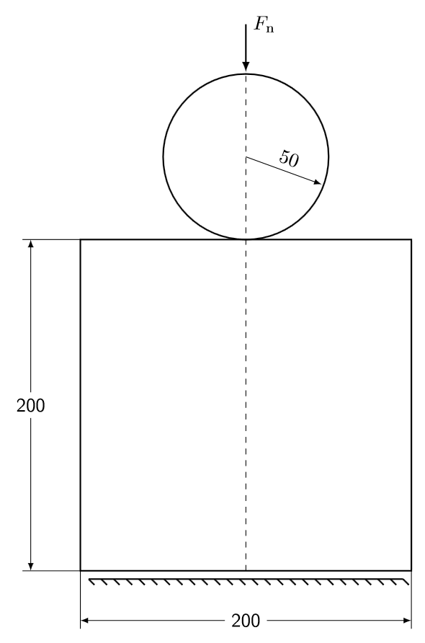
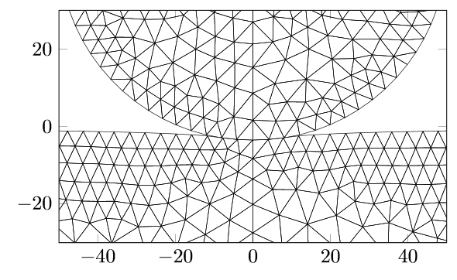
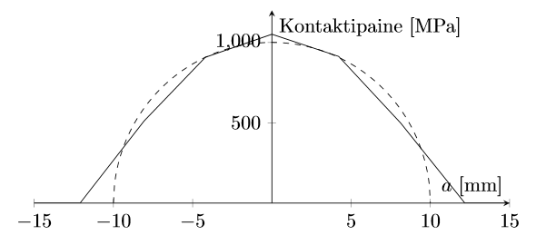
2D contact example: Hertz test

Slide 14
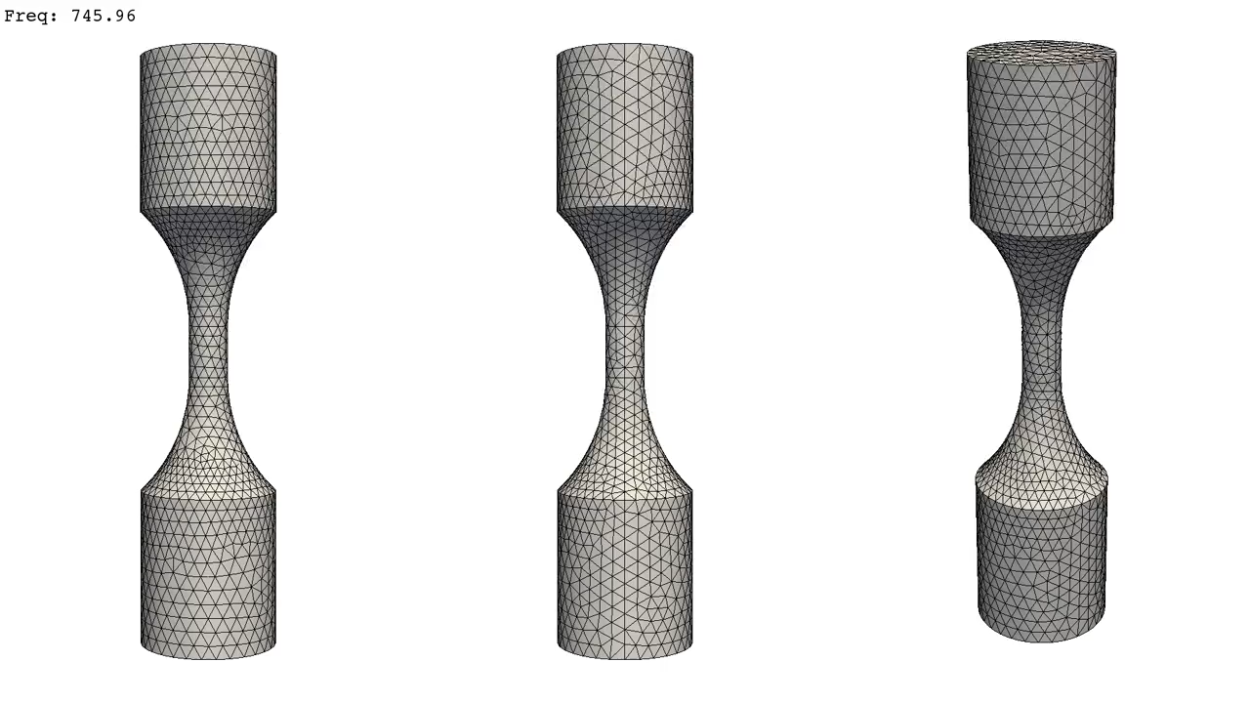
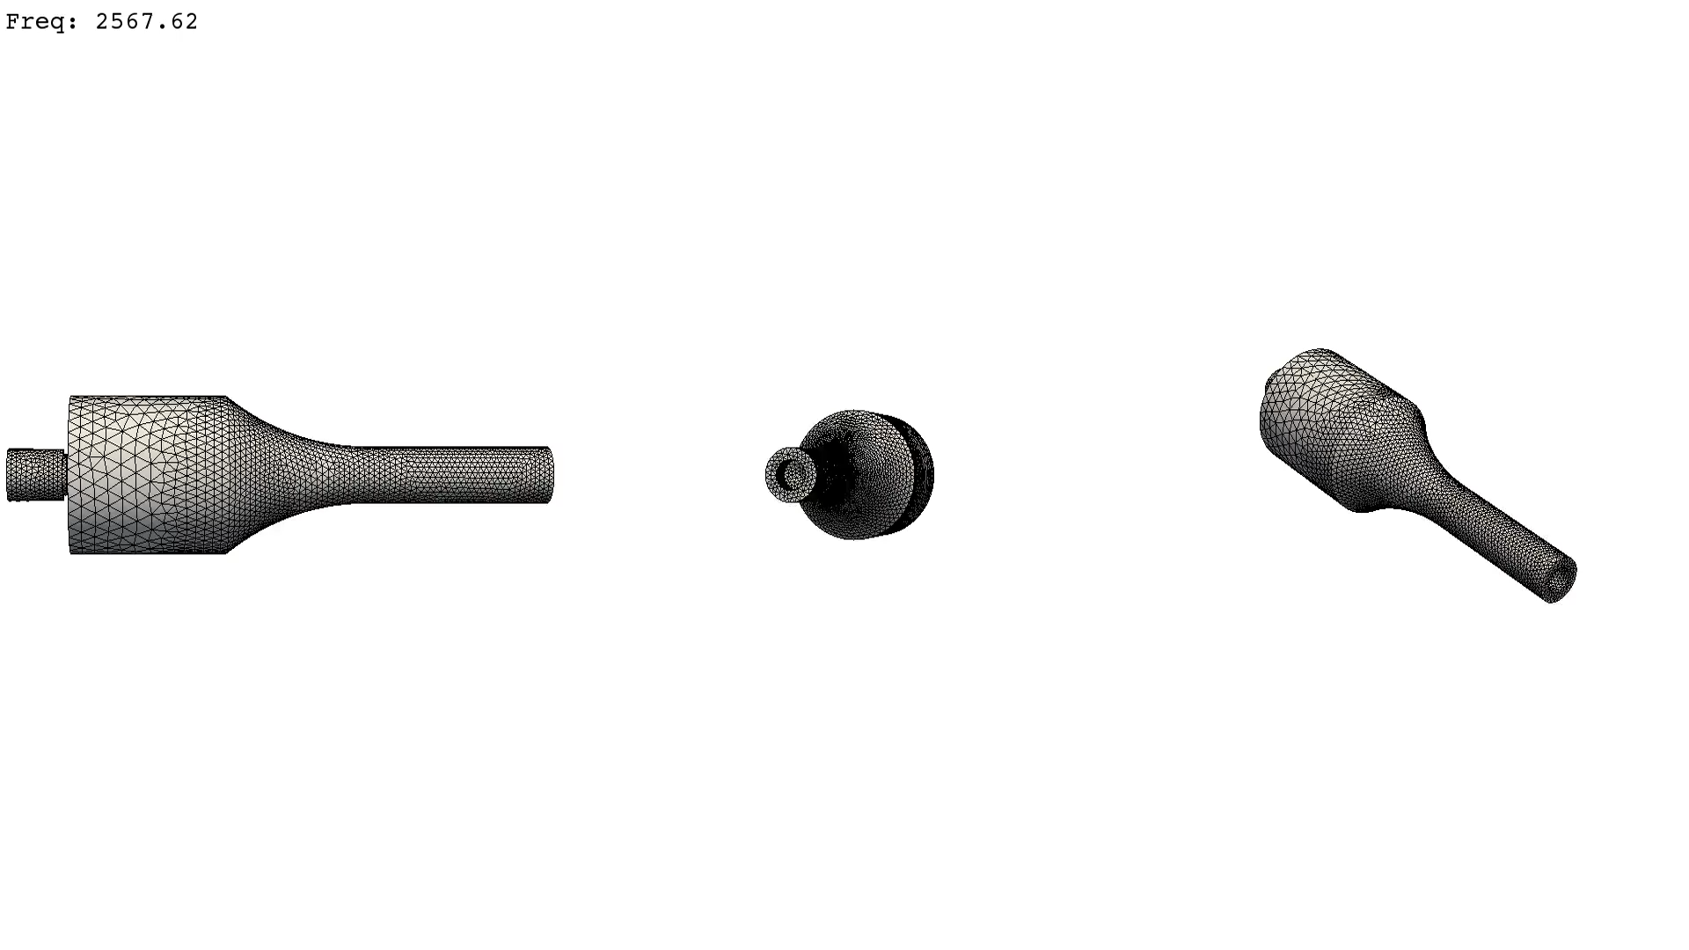
Simulation types
Steady state analysis for heat transfter and elasticity
Eigenvalue analysis
Linear perturbation analysis
First eigenmode of test specimen. Visualization: ParaView

Slide 15
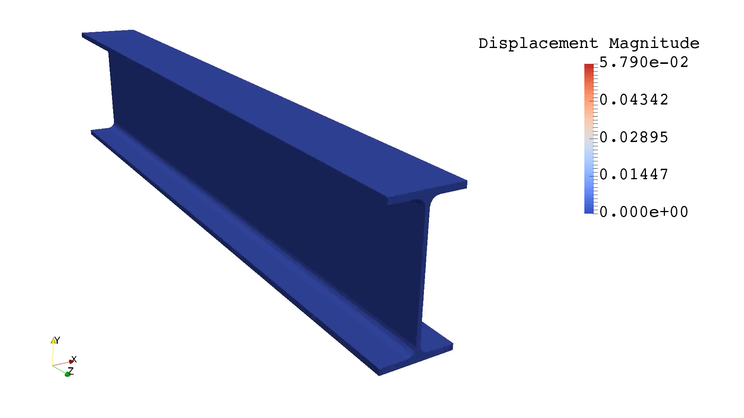
Boundary conditions
Boundary conditions (or in more general, ”fields”) can depend from time, spatial coordinates or from other fields.
Possibilities and benefits: modelling hydrostatic pressure, strain fields depending from depth from surface, material properties depending from temperature etc. etc. in very general way.
Displacement boundary conditions can be formulated in weak form.
Animation: displacement boundary condition given as function $u=\left\|X\right\|\left[\begin{matrix}\cos{ωt} \\ \sin{ωt}\end{matrix}\right]$

Slide 16
Thermal analysis of heat sink
Visualization: ParaView

Slide 17
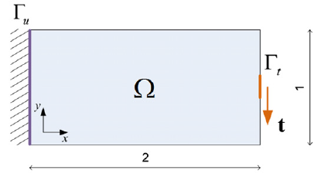
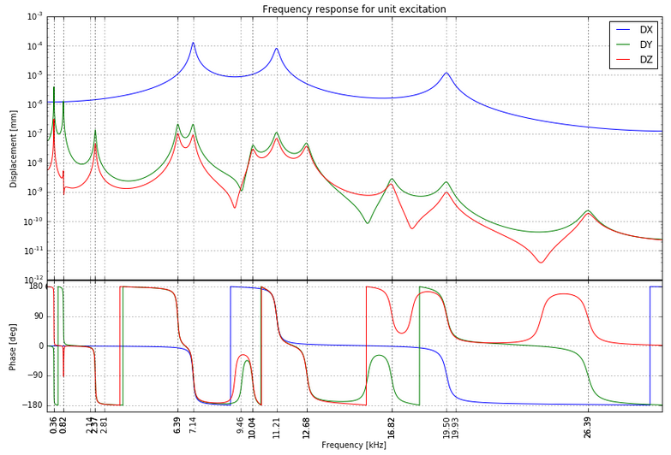

Ideas and future plans
Create optimization loops.
For example, FE model fitting to measurement data.
Topology optimization.
Find optimum shape of a design
Fit FE model to vibration measurement data

Slide 18
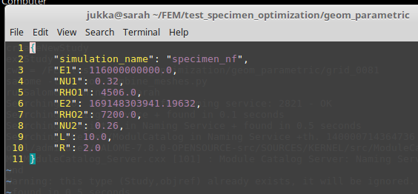
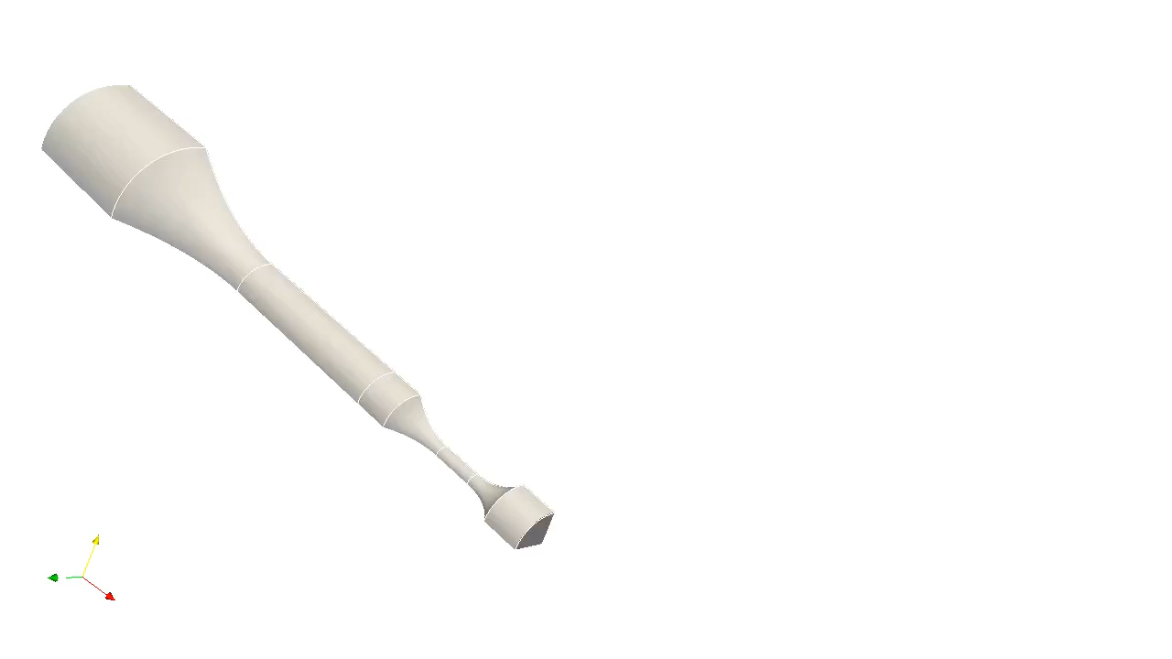
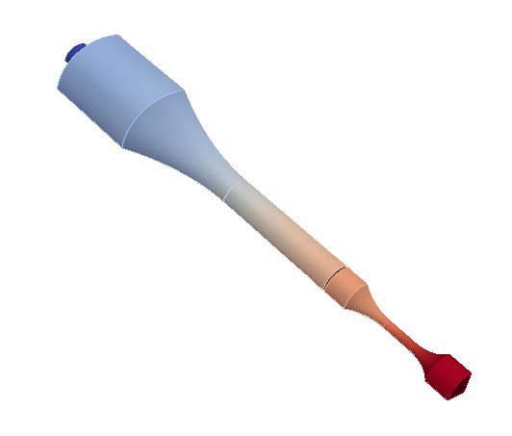
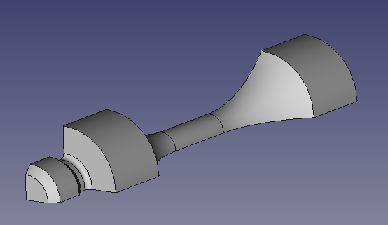
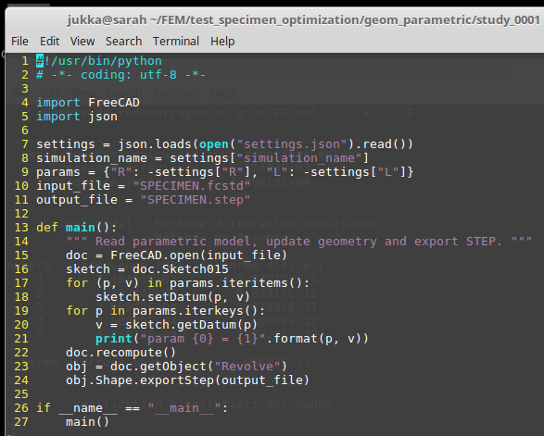
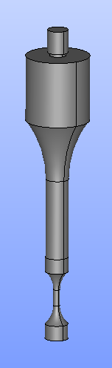
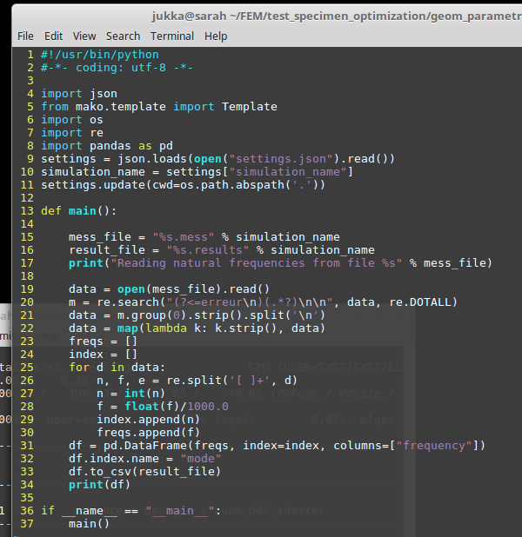
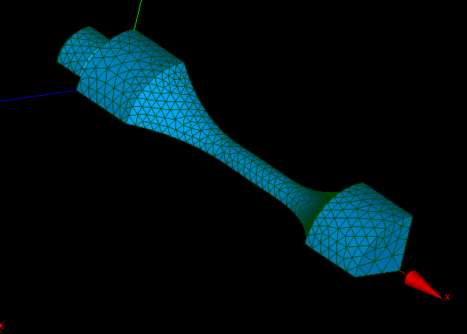
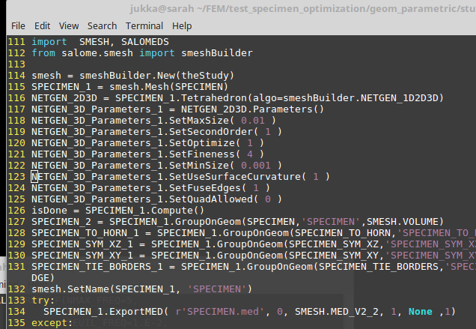
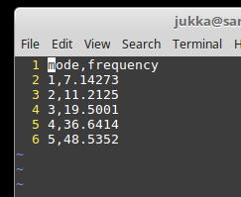
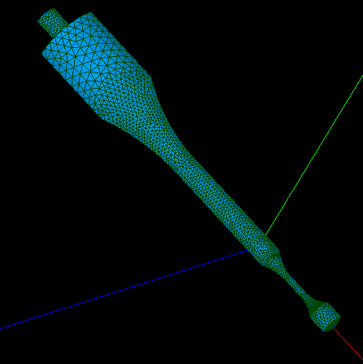
Ideas and future plans parametric models + scripting
Create geometry using FreeCAD
Create mesh (SALOME)
Combine meshes (SALOME)
Natural frequency analysis (JuliaFEM)
Extract results (Python)
Optimization and update settings
Read settings from JSON file
Postprocess (Paraview)

